Slide 1
EIGRP Implementation
Implementing EIGRP

Slide 2
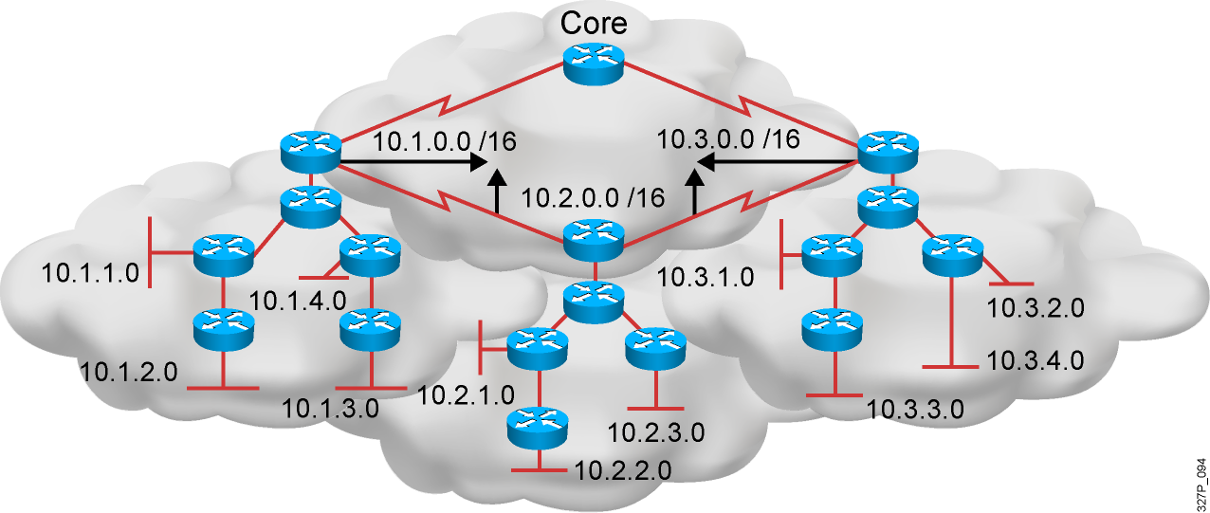
EIGRP Features
Advanced distance vector
Rapid convergence
100% loop-free classless routing
Easy configuration
Incremental updates
Load balancing across equal-
and unequal-cost pathways
Flexible network design
Multicast and unicast instead of broadcast
address
Support for VLSM and discontiguous subnets
Manual summarization at any point in the
internetwork
Support for multiple network layer protocols

Slide 3
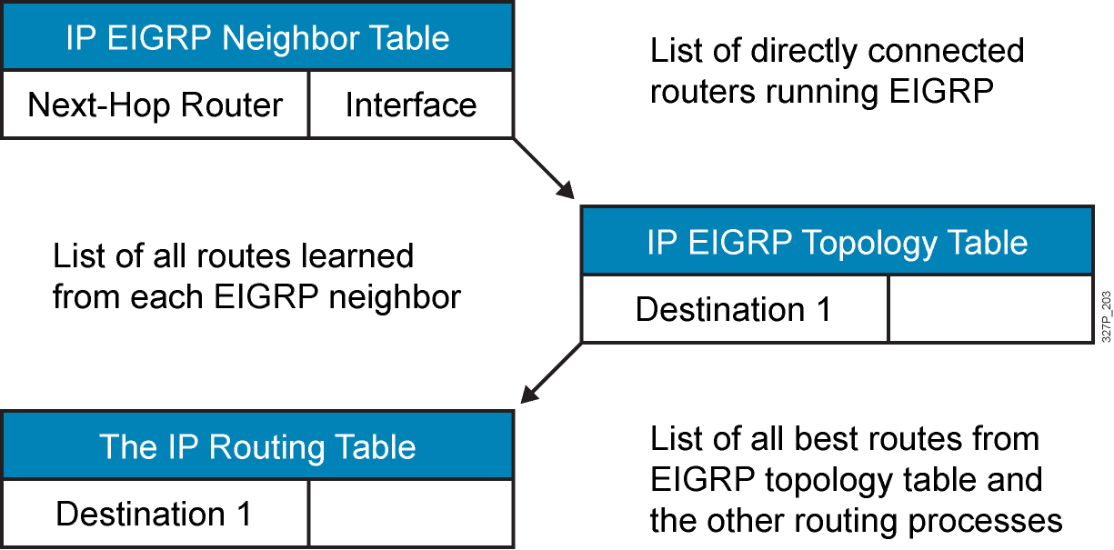
EIGRP Tables

Slide 4
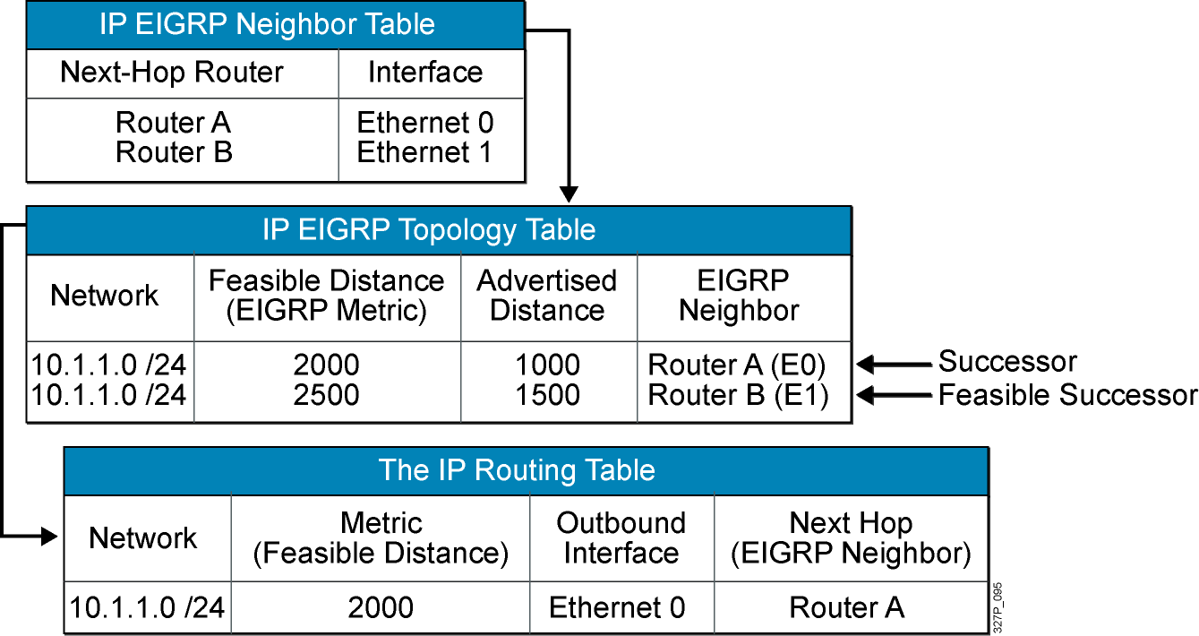
EIGRP Path Calculation (Router C)

Slide 5
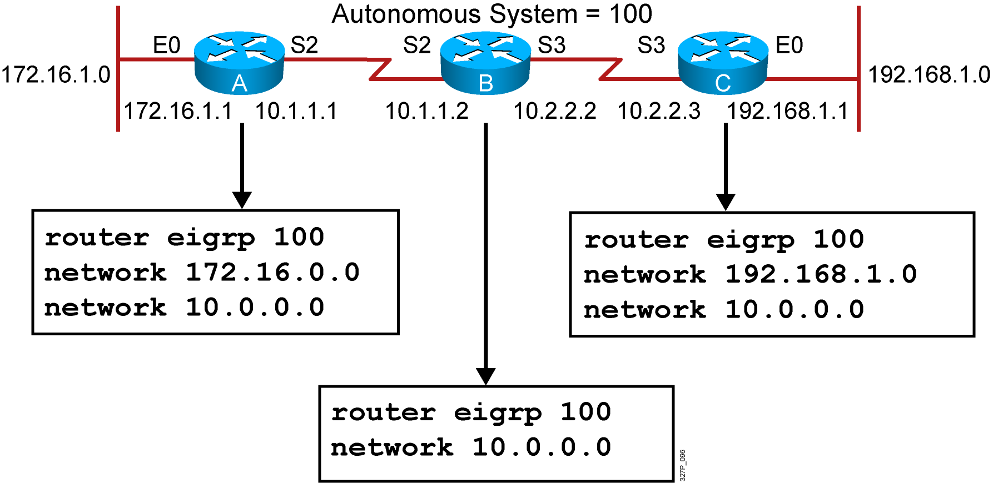
EIGRP Configuration
RouterX(config)# router eigrp autonomous-system
RouterX(config-router)# network network-number
Notes:
Purpose: The figure shows how the IGRP commands operate on the example network.
Emphasize: An administrator only specifies directly connected networks that should be published to other routers.
Without the network command, nothing is advertised. With a network command, the router will advertise every subnet within the Class A, B, or C network specified in the configuration.

Slide 6
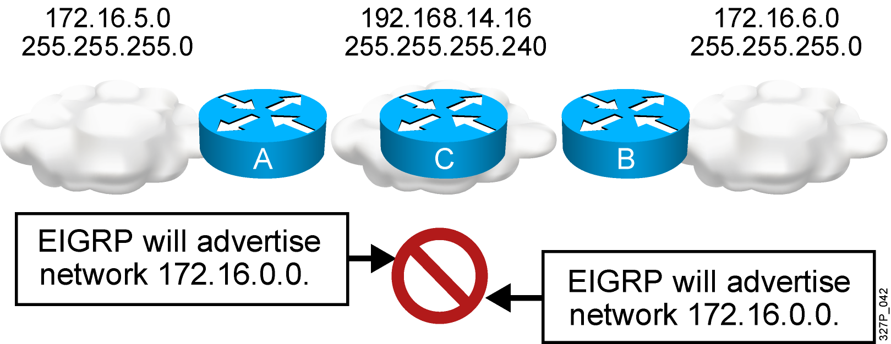
EIGRP and Discontiguous Networks Default Scenario Configuration
EIGRP, by default, does not advertise subnets and, therefore, cannot support discontiguous subnets.

Slide 7
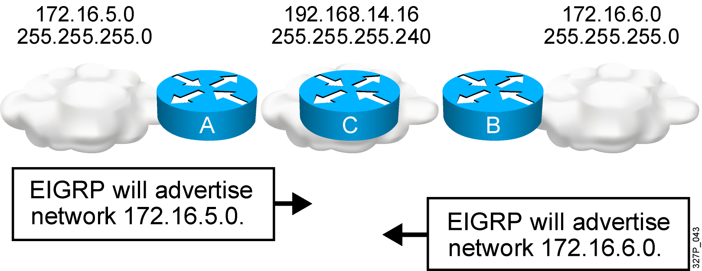
EIGRP and Discontiguous Networks with no auto-summary
EIGRP with the no auto-summary parameter can advertise
subnets and, therefore, can support discontiguous subnets.

Slide 8
Verifying the EIGRP Configuration
RouterX# show ip route eigrp
Displays the current EIGRP entries in the routing table
RouterX# show ip protocols
Displays the parameters and current state of the active process
RouterX# show ip eigrp interfaces
Displays information about interfaces configured for EIGRP
RouterX# show ip eigrp interfaces
IP EIGRP interfaces for process 109
Xmit Queue Mean Pacing Time Multicast Pending
Interface Peers Un/Reliable SRTT Un/Reliable Flow Timer Routes
Di0 0 0/0 0 11/434 0 0
Et0 1 0/0 337 0/10 0 0
SE0:1.16 1 0/0 10 1/63 103 0
Tu0 1 0/0 330 0/16 0 0
Notes:
Purpose: This figure shows how the show ip protocol command is used to monitor IGRP operation.
Emphasize: The command displays the routing protocols that are active on the router for IP. It also gives network and timer information. In this example, IGRP is displayed.
Point out the timing information.
Point out the list of networks for which the router is injecting routes.
Point out the administrative distance metric.

Slide 9
Verifying the EIGRP Configuration (Cont.)
RouterX# show ip eigrp neighbors [detail]
Displays the neighbors discovered by IP EIGRP
RouterX# show ip eigrp neighbors
IP-EIGRP Neighbors for process 77
Address Interface Holdtime Uptime Q Seq SRTT RTO
(secs) (h:m:s) Count Num (ms) (ms)
172.16.81.28 Ethernet1 13 0:00:41 0 11 4 20
172.16.80.28 Ethernet0 14 0:02:01 0 10 12 24
172.16.80.31 Ethernet0 12 0:02:02 0 4 5 20
Notes:
Purpose: This figure shows how the show ip protocol command is used to monitor IGRP operation.
Emphasize: The command displays the routing protocols that are active on the router for IP. It also gives network and timer information. In this example, IGRP is displayed.
Point out the timing information.
Point out the list of networks for which the router is injecting routes.
Point out the administrative distance metric.

Slide 10
Verifying the EIGRP Configuration (Cont.)
RouterX# show ip eigrp topology [all]
Displays the IP EIGRP topology table
Without the [all] parameter, shows successors and feasible successors
RouterX# show ip eigrp topology
IP-EIGRP Topology Table for process 77
Codes: P - Passive, A - Active, U - Update, Q - Query, R - Reply,
r - Reply status
P 172.16.90.0 255.255.255.0, 2 successors, FD is 46251776
via 172.16.80.28 (46251776/46226176), Ethernet0
via 172.16.81.28 (46251776/46226176), Ethernet1
via 172.16.80.31 (46277376/46251776), Serial0
P 172.16.81.0 255.255.255.0, 2 successors, FD is 307200
via Connected, Ethernet1
via 172.16.81.28 (307200/281600), Ethernet1
via 172.16.80.28 (307200/281600), Ethernet0
via 172.16.80.31 (332800/307200), Serial0
Notes:
240, 197, 102

Slide 11
Verifying the EIGRP Configuration (Cont.)
RouterX# show ip eigrp traffic
Displays the number of IP EIGRP packets sent and received
RouterX# show ip eigrp traffic
IP-EIGRP Traffic Statistics for process 77
Hellos sent/received: 218/205
Updates sent/received: 7/23
Queries sent/received: 2/0
Replies sent/received: 0/2
Acks sent/received: 21/14
Notes:
Purpose: This figure shows how the show ip protocol command is used to monitor IGRP operation.
Emphasize: The command displays the routing protocols that are active on the router for IP. It also gives network and timer information. In this example, IGRP is displayed.
Point out the timing information.
Point out the list of networks for which the router is injecting routes.
Point out the administrative distance metric.

Slide 12
debug ip eigrp Command
RouterX# debug ip eigrp
IP-EIGRP: Processing incoming UPDATE packet
IP-EIGRP: Ext 192.168.3.0 255.255.255.0 M 386560 - 256000 130560 SM 360960 –
256000 104960
IP-EIGRP: Ext 192.168.0.0 255.255.255.0 M 386560 - 256000 130560 SM 360960 –
256000 104960
IP-EIGRP: Ext 192.168.3.0 255.255.255.0 M 386560 - 256000 130560 SM 360960 –
256000 104960
IP-EIGRP: 172.69.43.0 255.255.255.0, - do advertise out Ethernet0/1
IP-EIGRP: Ext 172.69.43.0 255.255.255.0 metric 371200 - 256000 115200
IP-EIGRP: 192.135.246.0 255.255.255.0, - do advertise out Ethernet0/1
IP-EIGRP: Ext 192.135.246.0 255.255.255.0 metric 46310656 - 45714176 596480
IP-EIGRP: 172.69.40.0 255.255.255.0, - do advertise out Ethernet0/1
IP-EIGRP: Ext 172.69.40.0 255.255.255.0 metric 2272256 - 1657856 614400
IP-EIGRP: 192.135.245.0 255.255.255.0, - do advertise out Ethernet0/1
IP-EIGRP: Ext 192.135.245.0 255.255.255.0 metric 40622080 - 40000000 622080
IP-EIGRP: 192.135.244.0 255.255.255.0, - do advertise out Ethernet0/1
Note: EIGRP routes are exchanged only when a change in topology occurs.

Slide 13
EIGRP Metric
The criteria that EIGRP uses by default to calculate its metric:
  Bandwidth
  Delay
The optional criteria that EIGRP can be configured to use when calculating its metric:
  Reliability
  Load
Note: Although MTU is exchanged in EIGRP packets between neighbor routers, MTU is not factored into the EIGRP metric calculation.

Slide 14
EIGRP Load Balancing
  By default, EIGRP does equal-metric load balancing:
    By default, up to four routes with a metric equal to the minimum metric are installed in the routing table.
  There can be up to 16 entries in the routing table for the same destination:
    The number of entries is configurable with the
    maximum-paths command.

Slide 15
EIGRP Unequal-Cost Load Balancing
RouterX(config-router)#
variance multiplier
Allows the router to load-balance across routes with a metric
smaller than the multiplier value times the minimum metric route
to that destination.
The default variance is 1, which means equal-cost load balancing.

Slide 16
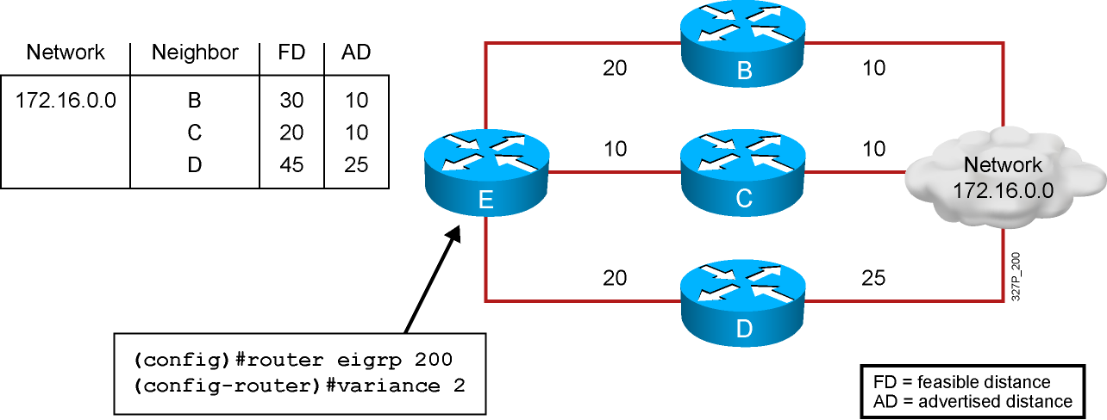
Variance Example
Router E chooses router C to route to network 172.16.0.0 because it has the lowest feasible distance of 20.
With a variance of 2, router E also chooses router B to route to network 172.16.0.0 (20 + 10 = 30) < [2 * (FD) = 40].
Router D is not considered to route to network 172.16.0.0 (because 25 > 20).

Slide 17
EIGRP MD5 Authentication
  EIGRP supports MD5 authentication.
  The router identifies itself for every EIGRP packet it sends.
  The router authenticates the source of each routing update packet that it receives.
  Each participating neighbor must have the same key configured.

Slide 18
EIGRP MD5 Authentication Configuration Steps
  Create the keychain, a group of possible keys (passwords).
  Assign a key ID to each key.
  Identify the keys.
  (Optional) Specify the duration a key will be valid.
  Enable MD5 authentication on the interface.
  Specify which keychain the interface will use.

Slide 19
Configuring EIGRP MD5 Authentication
RouterX(config)#
key chain name-of-chain
Enters the configuration mode for the keychain
RouterX(config-keychain)#
key key-id
Identifies the key and enters the configuration mode for the key ID

Slide 20
Configuring EIGRP MD5 Authentication (Cont.)
RouterX(config-keychain-key)#
key-string text
Identifies the key string (password)
RouterX(config-keychain-key)#
accept-lifetime start-time {infinite | end-time | duration
seconds}
(Optional) Specifies when the key is accepted for received packets
RouterX(config-keychain-key)#
send-lifetime start-time {infinite | end-time | duration
seconds}
(Optional) Specifies when the key can be used for sending packets

Slide 21
Configuring EIGRP MD5 Authentication (Cont.)
RouterX(config-if)#
ip authentication mode eigrp autonomous-system md5
Specifies MD5 authentication for EIGRP packets
RouterX(config-if)#
ip authentication key-chain eigrp autonomous-system
name-of-chain
Enables authentication of EIGRP packets using the key in the keychain

Slide 22
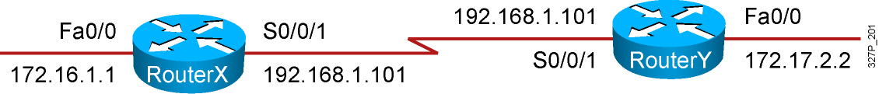
Example EIGRP MD5 Authentication Configuration
RouterX
<output omitted>
key chain RouterXchain
key 1
key-string firstkey
accept-lifetime 04:00:00 Jan 1 2006 infinite
send-lifetime 04:00:00 Jan 1 2006 04:01:00 Jan 1 2006
key 2
key-string secondkey
accept-lifetime 04:00:00 Jan 1 2006 infinite
send-lifetime 04:00:00 Jan 1 2006 infinite
<output omitted>
!
interface Serial0/0/1
bandwidth 64
ip address 192.168.1.101 255.255.255.224
ip authentication mode eigrp 100 md5
ip authentication key-chain eigrp 100 RouterXchain

Slide 23
Example EIGRP MD5 Authentication Configuration (Cont.)
RouterY
<output omitted>
key chain RouterYchain
key 1
key-string firstkey
accept-lifetime 04:00:00 Jan 1 2006 infinite
send-lifetime 04:00:00 Jan 1 2006 infinite
key 2
key-string secondkey
accept-lifetime 04:00:00 Jan 1 2006 infinite
send-lifetime 04:00:00 Jan 1 2006 infinite
<output omitted>
!
interface Serial0/0/1
bandwidth 64
ip address 192.168.1.102 255.255.255.224
ip authentication mode eigrp 100 md5
ip authentication key-chain eigrp 100 RouterYchain

Slide 24
Verifying MD5 Authentication
RouterX#
*Jan 21 16:23:30.517: %DUAL-5-NBRCHANGE: IP-EIGRP(0) 100: Neighbor 192.168.1.102
(Serial0/0/1) is up: new adjacency
RouterX#show ip eigrp neighbors
IP-EIGRP neighbors for process 100
H Address Interface Hold Uptime SRTT RTO Q Seq
(sec) (ms) Cnt Num
0 192.168.1.102 Se0/0/1 12 00:03:10 17 2280 0 14
RouterX#show ip route
<output omitted>
Gateway of last resort is not set
D 172.17.0.0/16 [90/40514560] via 192.168.1.102, 00:02:22, Serial0/0/1
172.16.0.0/16 is variably subnetted, 2 subnets, 2 masks
D 172.16.0.0/16 is a summary, 00:31:31, Null0
C 172.16.1.0/24 is directly connected, FastEthernet0/0
192.168.1.0/24 is variably subnetted, 2 subnets, 2 masks
C 192.168.1.96/27 is directly connected, Serial0/0/1
D 192.168.1.0/24 is a summary, 00:31:31, Null0
RouterX#ping 172.17.2.2
Type escape sequence to abort.
Sending 5, 100-byte ICMP Echos to 172.17.2.2, timeout is 2 seconds:
!!!!!
Success rate is 100 percent (5/5), round-trip min/avg/max = 12/15/16 ms

Slide 25
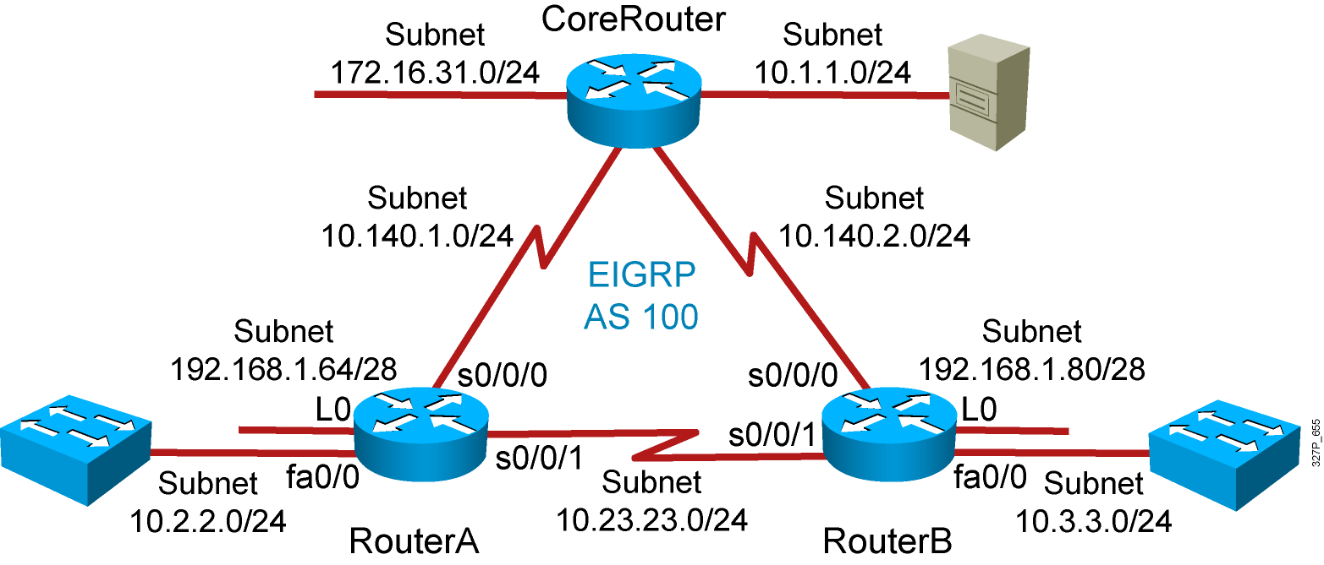
Visual Objective 5-1:
Implementing EIGRP
Notes:
Lab 10 amended pod b and pod I addresses move core_ro address closer to interface same with s0 pod L
Objectives: Enable the IGRP dynamic routing protocol so your router can learn about nonconnected networks.
Purpose: Teach students how to enable IGRP.
Laboratory Instructions: Refer to the lab setup guide.

Slide 26
Summary
  EIGRP is a classless, advanced distance vector routing protocol that runs the DUAL algorithm.
  EIGRP requires you to configure an autonomous system number that must match on all routers to exchange routes.
  EIGRP is capable of load balancing across unequal-cost paths.
  EIGRP supports MD5 authentication to protect against unauthorized, rogue routers entering your network.

